Slide 1
Fully Homomorphic Encryption
Craig Gentry
IBM T.J. Watson Research Center
March 2017
Spring School on Lattice-Based Crypto, Oxford

Slide 2
Learning with Errors (LWE)

Slide 3
Solving Linear Equations
A
s
b
=
(mod q)

Slide 4


Solving Linear Equations
Noisy
A
s
e
b
+
=
(mod q)
Notes:
Gaussian elimination fails here.

Slide 5
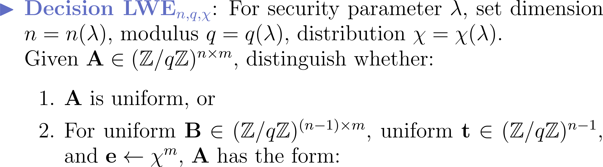
The Learning with Errors (LWE) Problem [Regev 2005]
B
b = tB+e

Slide 6
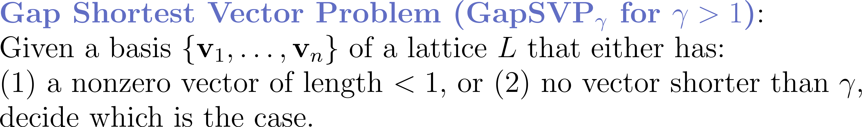
Why Do We Think LWE Is Hard?
v₂’
v₁’
v₂
v₁
0

Slide 7
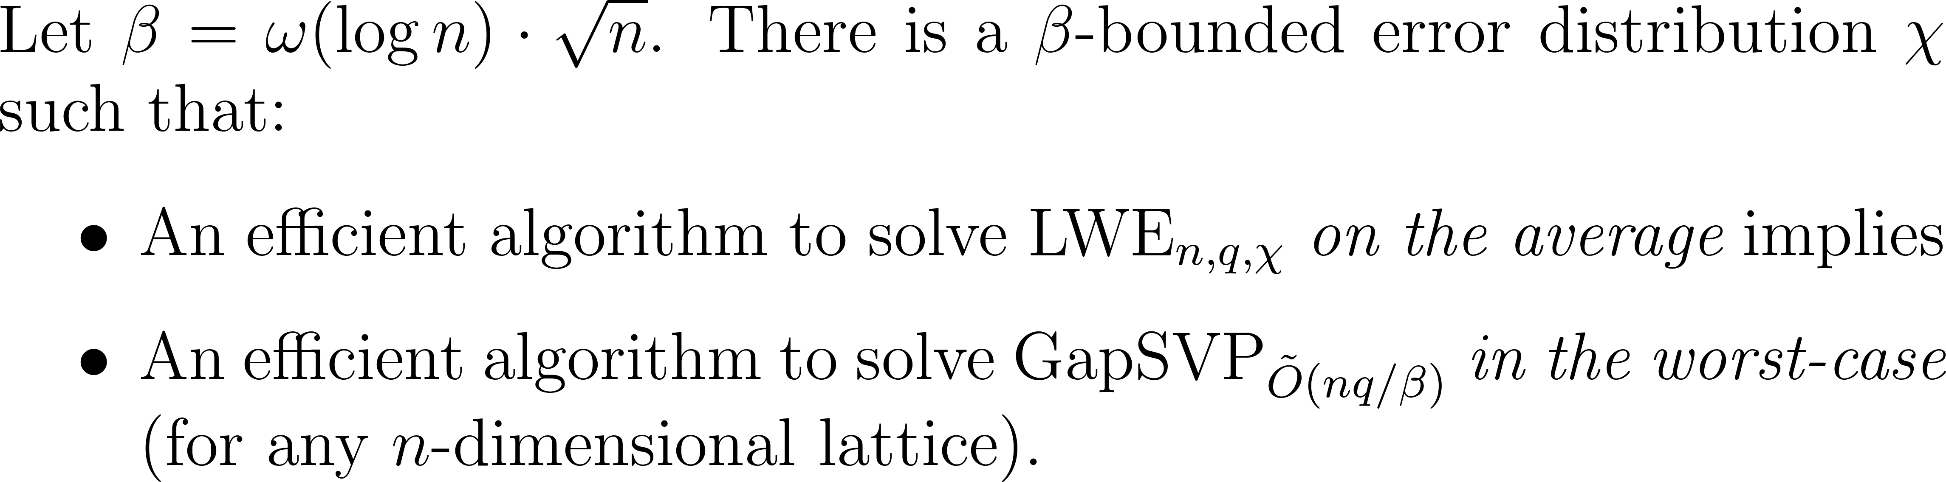
Why Do We Think LWE Is Hard?

Slide 8

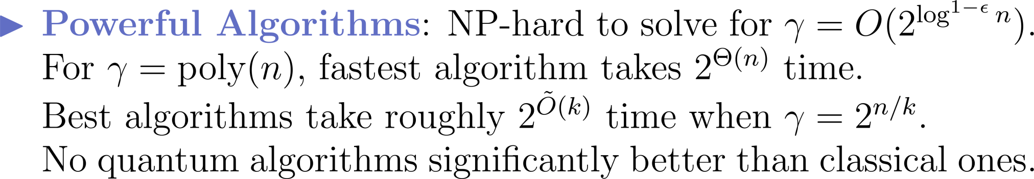
Why Do We Think LWE Is Hard?

Slide 9
LWE-Based Encryption [Regev ‘05]

Slide 10


Regev’s Cryptosystem
A
B
=
b = tB+e

Slide 11


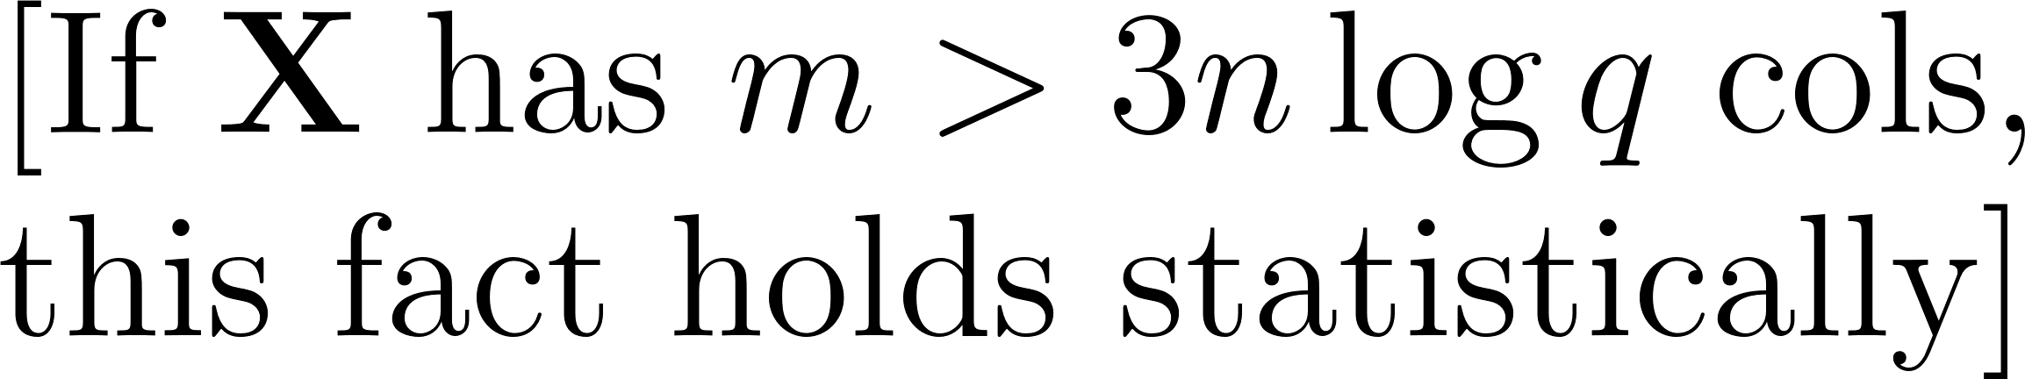
Security

Slide 12
Leveled FHE Based on LWE
Focusing on the Gentry-Sahai-Waters (GSW) scheme.
(Brakerski and Vaikuntanathan were the first to construct HE based on LWE.)

Slide 13
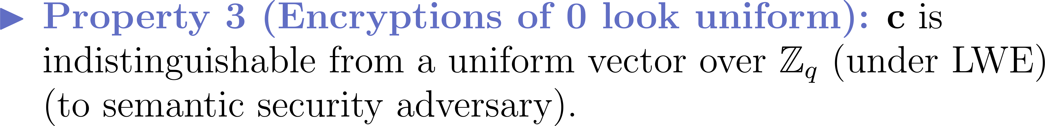
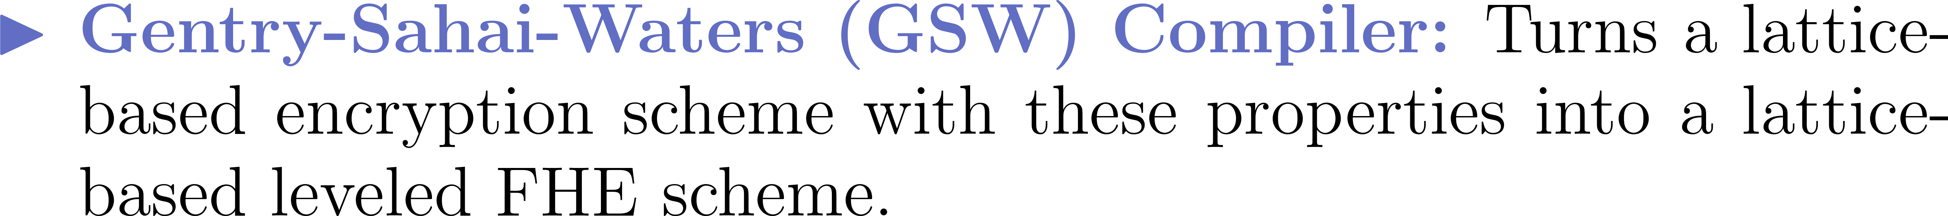
Properties of Regev’s Scheme

Slide 14
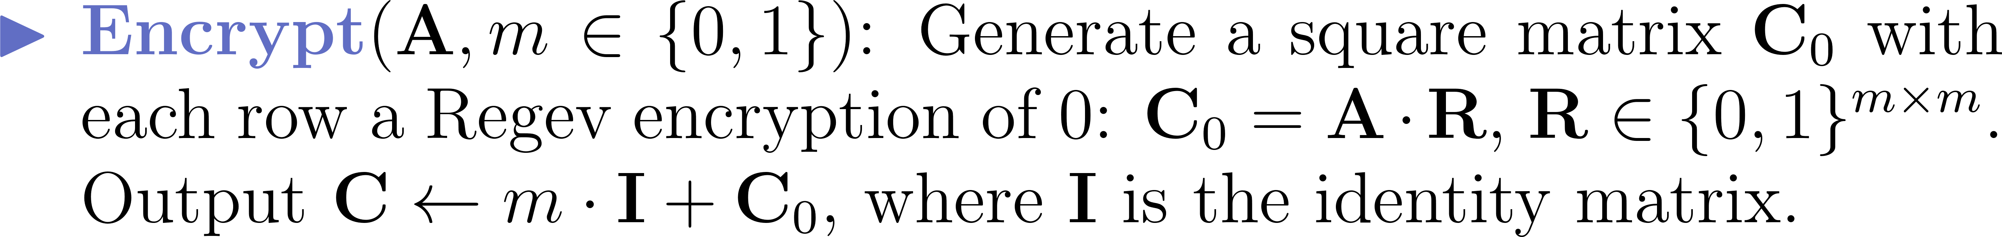
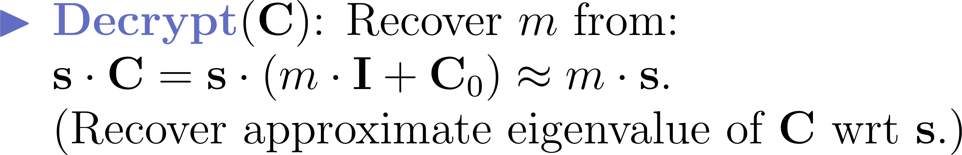
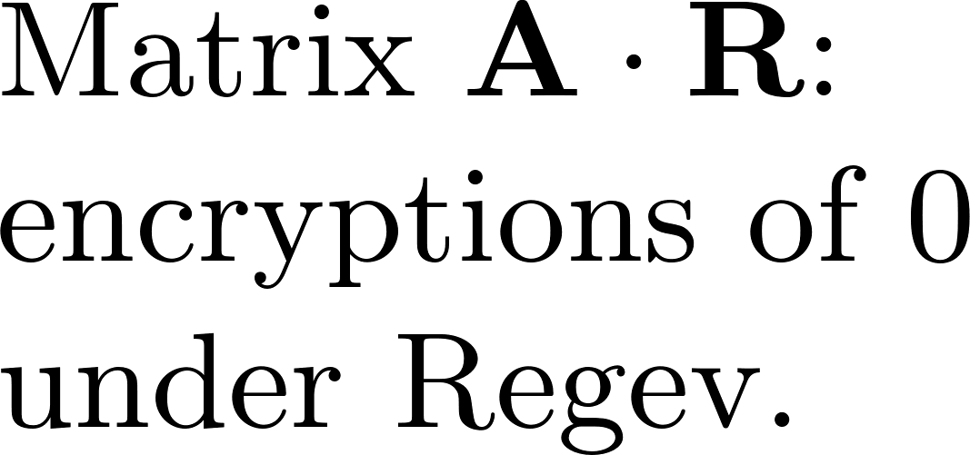
Matrix Version of Regev (1st Attempt)
C
m
c₁ = Enc(0)
m
c₂ = Enc(0)
=
m
+
…
…
m
c_{n} = Enc(0)

Slide 15
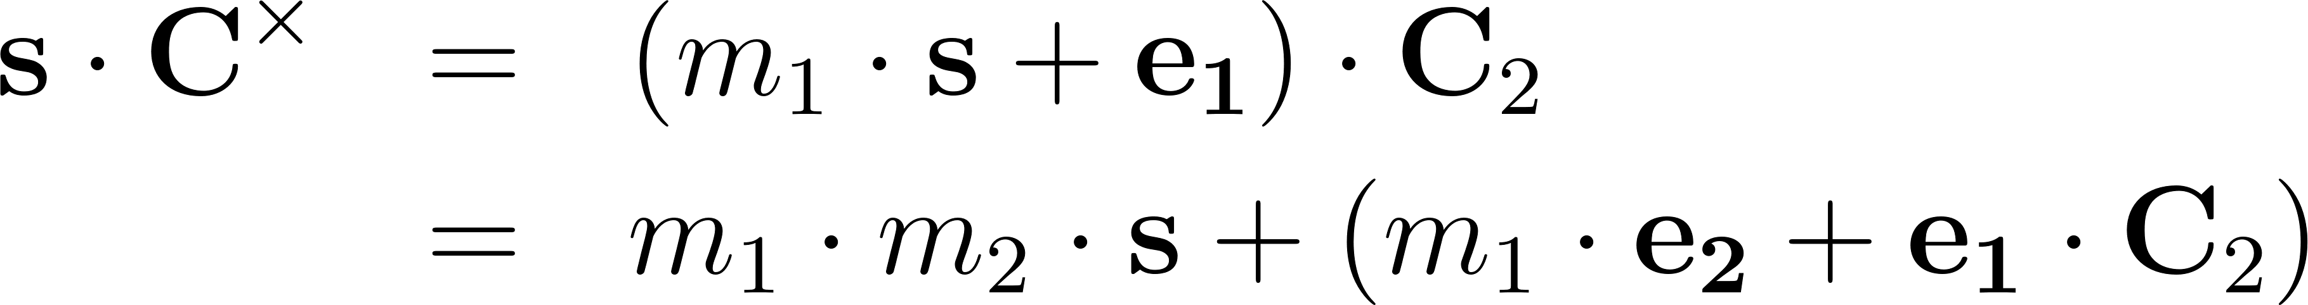
Approximate Eigenvector Homomorphisms
New Noise

Slide 16
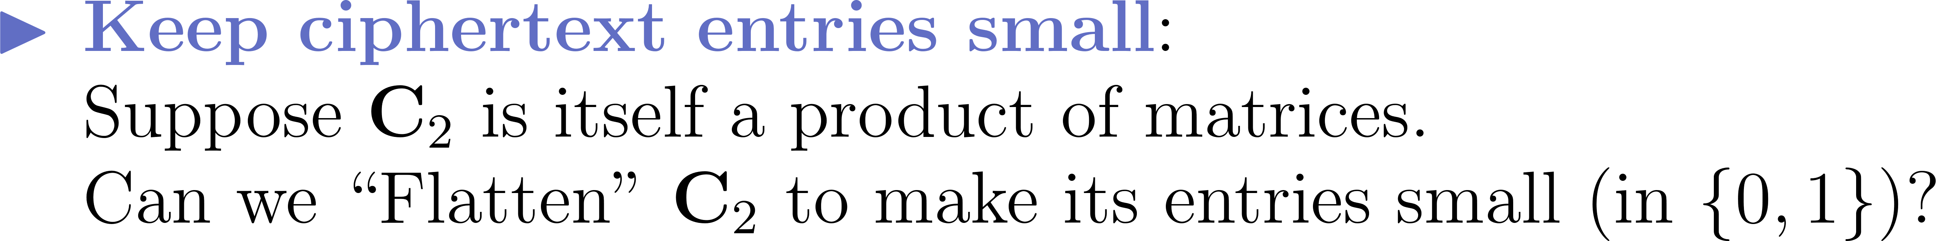
Controlling the Noise
New Noise

Slide 17
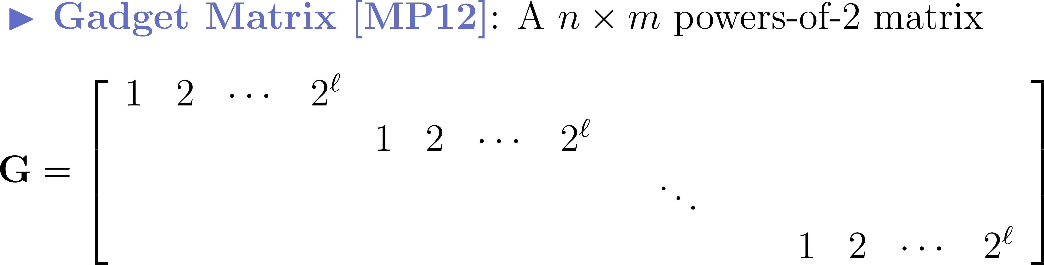
The Gadget Matrix

Slide 18
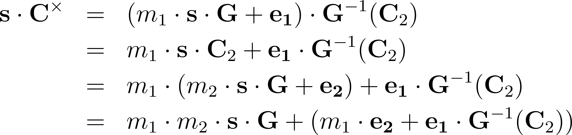
Flattening Ciphertexts via Gadget Matrix
Security of new encryption follows from Regev.
New Noise is small.

Slide 19
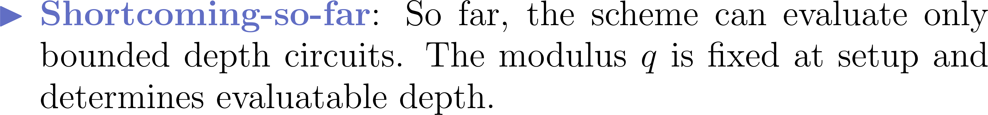
Summary of GSW HE Scheme

Slide 20
Identity-Based HE

Slide 21
Identity-Based FHE (IBFHE)

Slide 22
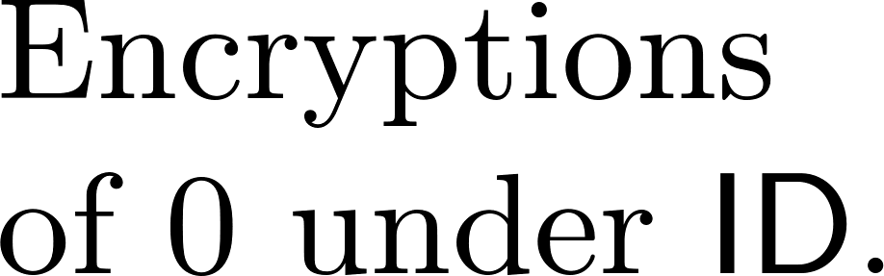


GSW IBE → IBFHE Compiler
C_{ID}
C’_{ID}
=
+

Slide 23
Attribute-Based FHE (ABFHE)

Slide 24
Multi-Key HE
Slides from Daniel Wichs

Slide 25
Multi-Key HE

Slide 26
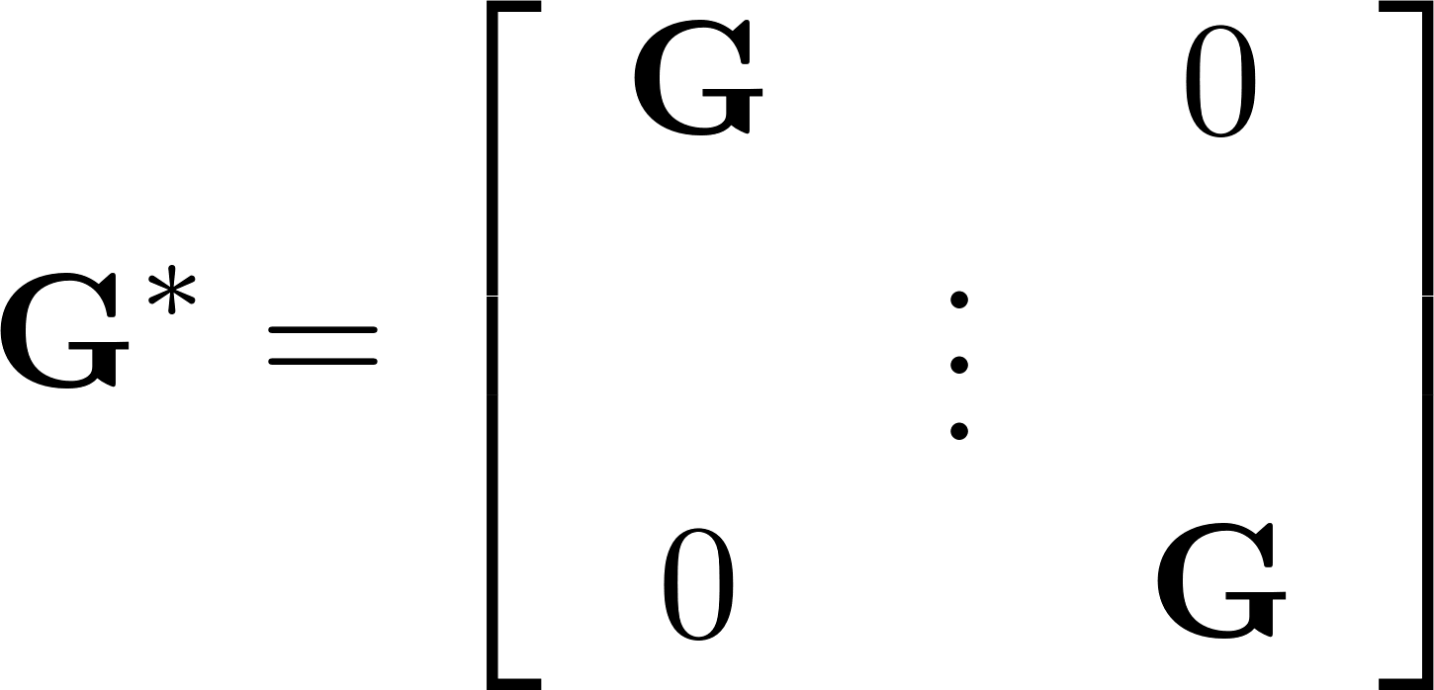
Multi-Key Version of GSW

Slide 27
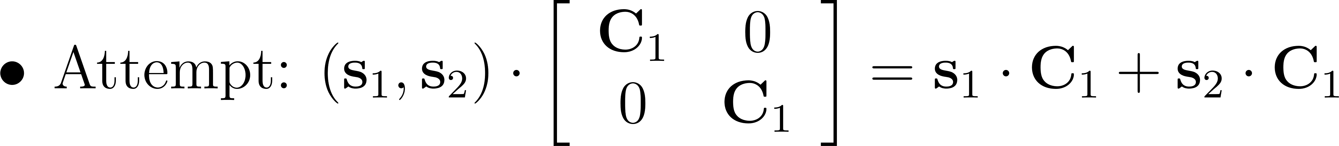
Expanded Ciphertexts
B
B
A₁
A₂
=
=
b₁ = t₁B+e₁
b₂ = t₂B+e₂

Slide 28
Expanded Ciphertexts
B
B
A₁
A₂
=
=
b₁ = t₁B+e₁
b₂ = t₂B+e₂

Slide 29
Bootstrapping GSW

Slide 30
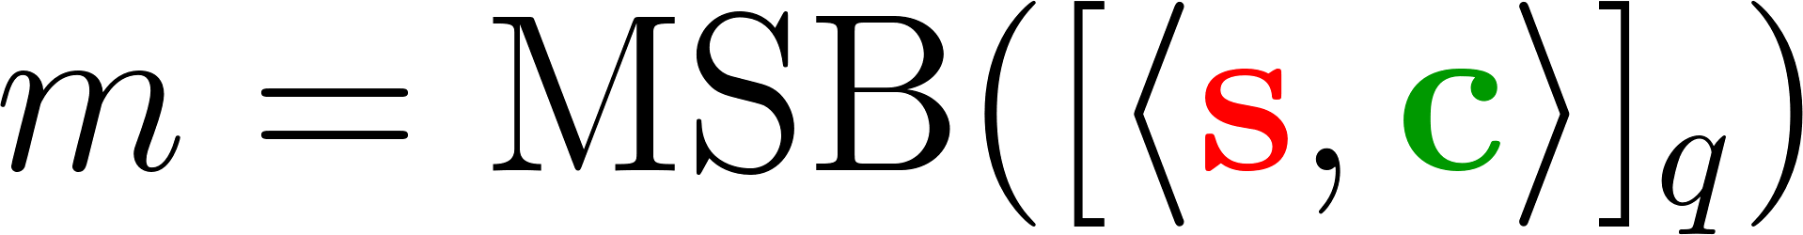
Evaluating an Actual Decryption Circuit

Slide 31
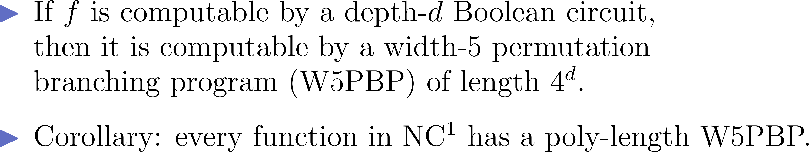
Barrington’s Theorem

Slide 32
Width-5 Permutation Branching Programs
A_{1,0}
A_{2,0}
A_{3,0}
A_{4,0}
A_{5,0}
A_{6,0}
A_{7,0}
A_{8,0}
A_{9,0}
A_{1,1}
A_{2,1}
A_{3,1}
A_{4,1}
A_{5,1}
A_{6,1}
A_{7,1}
A_{8,1}
A_{9,1}
0

Slide 33
Width-5 Permutation Branching Programs
A_{1,0}
A_{2,0}
A_{3,0}
A_{4,0}
A_{5,0}
A_{6,0}
A_{7,0}
A_{8,0}
A_{9,0}
A_{1,1}
A_{2,1}
A_{3,1}
A_{4,1}
A_{5,1}
A_{6,1}
A_{7,1}
A_{8,1}
A_{9,1}
0
1

Slide 34
Width-5 Permutation Branching Programs
A_{1,0}
A_{2,0}
A_{3,0}
A_{4,0}
A_{5,0}
A_{6,0}
A_{7,0}
A_{8,0}
A_{9,0}
A_{1,1}
A_{2,1}
A_{3,1}
A_{4,1}
A_{5,1}
A_{6,1}
A_{7,1}
A_{8,1}
A_{9,1}
0
1
1
0

Slide 35
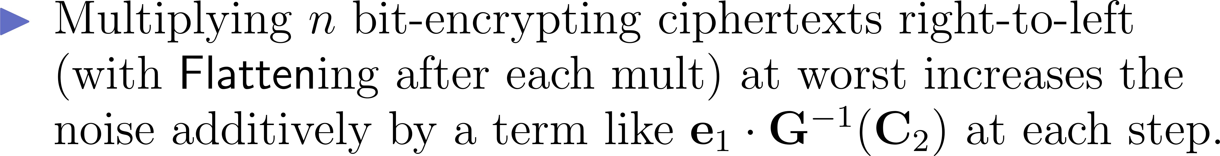
Brakerski and Vaikuntanathan’s Insight

Slide 36
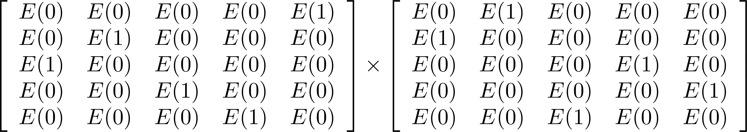
Brakerski and Vaikuntanathan’s Insight

Slide 37
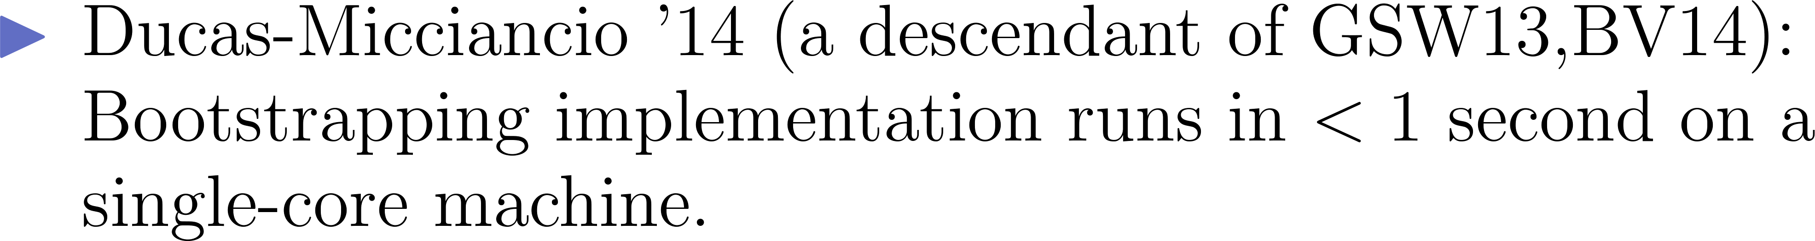
Bootstrapping GSW is Fast

Slide 38
Thank You! Questions?
TIME
EXPIRED
?
?

