Slide 1
Fully Homomorphic Encryption
Craig Gentry
IBM T.J. Watson Research Center
March 2017
Spring School on Lattice-Based Crypto, Oxford

Slide 2
Overview
Yesterday: Gentry-Sahai-Waters (GSW) FHE
  Most secure: Brakerski-Vaikuntanathan, “Lattice-based FHE as secure as [lattice-based] PKE”.
  Conceptually simple: approximate eigenvector method.
  Versatile: Identity-based, attribute-based, multi-key, …
  But not so practical:
    Bootstrapping is fast (< .1 seconds), but…
    Plaintexts are mere bits – overhead is inherently huge.

Slide 3
Overview
Today: More practical FHE systems
  Integer-based: van Dijk et al.
  Ring-LWE-based: BGV
    [Actually I cut this.]
  NTRU-based: Lopez-Alt et al. [But beware of attacks.]
Main Sources of Efficiency:
  Integer/Polynomial arithmetic (FFT), rather than matrices.
  Ciphertext packing: Each ctext can hold many plaintext bits.
Also, the unrealized “framework” for constructing FHE from noncommutative groups.

Slide 4
How To Construct HE: Revisited
Most Natural Approach
Ciphertexts live in a “ring”.
ADDing ciphertexts implicitly ADDs underlying plaintexts.
Same for MULT.
Examples of rings: integers Z, polynomials Z[x,y,…], …
Any function that you want to evaluate can be expressed as a sequence of ADDs and MULTs.

Slide 5
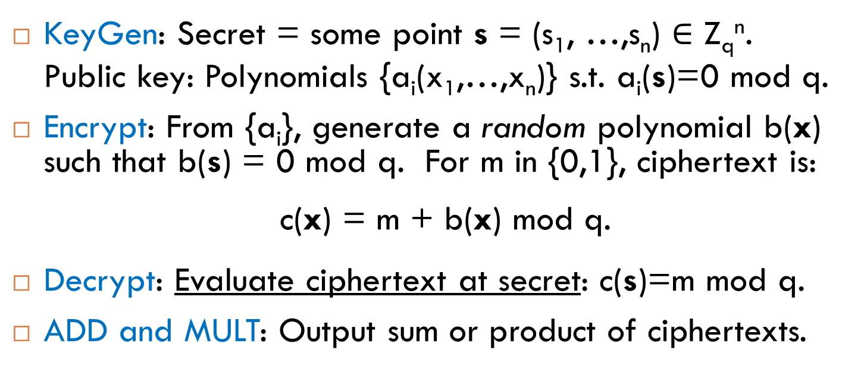
“Polly Cracker”: An Early Attempt at SWHE
[Fellows-Koblitz ‘93]
Main Idea
Encryptions of 0 evaluate to 0 at the secret key.
KeyGen: Secret = some point s = (s₁, …,s_{n}) $∈$ Z_{q}^{n}.
Public key: Polynomials {a_{i}(x₁,…,x_{n})} s.t. a_{i}(s)=0 mod q.
Encrypt: From {a_{i}}, generate a random polynomial b(x) such that b(s) = 0 mod q. For m in {0,1}, ciphertext is:
c(x) = m + b(x) mod q.
Decrypt: Evaluate ciphertext at secret: c(s)=m mod q.
ADD and MULT: Output sum or product of ciphertexts.

Slide 6
Polly Cracker Cryptanalysis [see AFFP11]
An Attack:
  Collect lots of encryptions {c_{i}} of 0.
  If the challenge ciphertext also encrypts 0, it will likely be in linear span of the given encryptions of 0.
    Use Gaussian elimination (linear algebra).
Can we modify Polly Cracker to make it secure?
Notes:
Albrecht, Farshim, Faugere, Perret

Slide 7
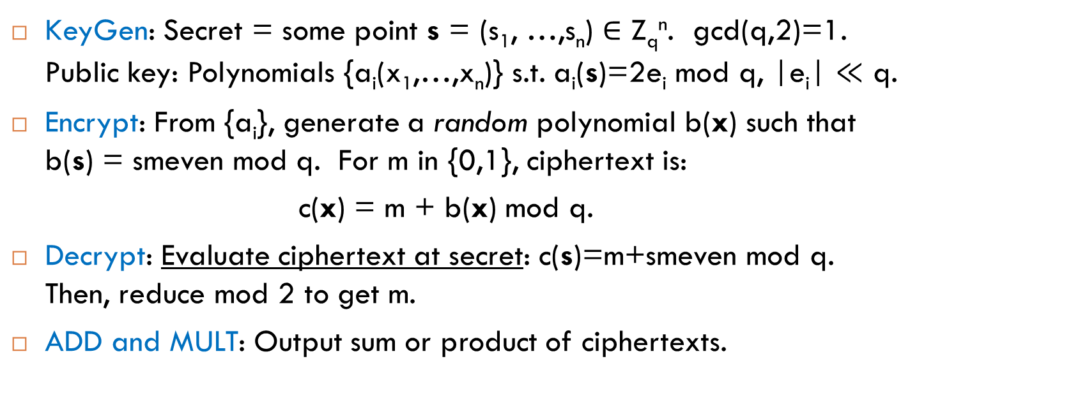
Noisy Polly Cracker: A Framework for Most Current SWHE Schemes [AFFP11]
Main Idea
Encryptions of 0 evaluate to something small and even (smeven) at the secret key.
KeyGen: Secret = some point s = (s₁, …,s_{n}) $∈$ Z_{q}^{n}. gcd(q,2)=1. Public key: Polynomials {a_{i}(x₁,…,x_{n})} s.t. a_{i}(s)=2e_{i} mod q, |e_{i}| $≪$ q.
Encrypt: From {a_{i}}, generate a random polynomial b(x) such that b(s) = smeven mod q. For m in {0,1}, ciphertext is:
c(x) = m + b(x) mod q.
Decrypt: Evaluate ciphertext at secret: c(s)=m+smeven mod q. Then, reduce mod 2 to get m.
ADD and MULT: Output sum or product of ciphertexts.

Slide 8
Noisy Polly Cracker: A Framework for Most Current SWHE Schemes
Main Idea
Encryptions of 0 evaluate to something small and even (smeven) at the secret key.
KeyGen: Secret = some point s = (s₁, …,s_{n}) $∈$ Z_{q}^{n}. gcd(q,2)=1. Public key: Polynomials {a_{i}(x₁,…,x_{n})} s.t. a_{i}(s)=2e_{i} mod q, |e_{i}| $≪$ q.
Encrypt: From {a_{i}}, generate a random polynomial b(x) such that b(s) = smeven mod q. For m in {0,1}, ciphertext is:
c(x) = m + b(x) mod q.
Decrypt: Evaluate ciphertext at secret: c(s)=m+smeven mod q. Then, reduce mod 2 to get m.
ADD and MULT: Output sum or product of ciphertexts.
We call [c(s) mod q] the “noise” of the ciphertext.
ADDs and MULTs make the “noise” grow.

Slide 9
SWHE with Integers
Main Idea
Encryptions of 0 are something small and even (smeven) modulo a secret integer.
Shared secret key: odd number p (= 101)
To encrypt a bit m in {0,1}: (say, m=0)
  Choose at random small r (=5), large q (=9)
  Output c = m + 2r + pq = 11 + 909 = 920
    Ciphertext is close to a multiple of p
    m = LSB of distance to nearest multiple of p
To decrypt c:
  Output m = (c mod p) mod 2 = 11 mod 2 = 1
“noise”

Slide 10
SWHE with Integers: Public Key Version
Secret key is an odd p as before
Public key has many “encryptions of 0”
  x_{i} = 2r_{i} + q_{i}p
E(pk, m) = m+subset-sum(x_{i}’s)
D(sk, c) = (c mod p) mod 2

Slide 11
Ciphertext Packing / Batching
Instead of one, select many integer p_{k}’s, k in [t].
Public keys includes:
  x_{i} such that x_{i} = 2r_{ik} + q_{ik}p_{k} for all k (encrypt 0 vectors).
  Additional y_{i} that encrypt basis vectors {e_{1,…,}e_{t}}.
Can operate on encrypted bit-vectors component-wise, in parallel.

Slide 12
Security of SWHE with Integers
Reduction:
  If “approximate gcd” problem is hard, then the scheme is semantically secure.
Approximate GCD Problem:
  Given many a_{i} = e_{i} + q_{i}∙p (approx multiples of p), output p.
  Example params: e_{i} ~ 2^{Ω(λ)}, p ~ 2^{Ω(λ^2)}, q_{i} ~ 2^{Ω(λ^5)}, where λ is the security parameter
    Best known attacks for these params (lattices) require 2^{λ} time
Approx GCD modified when there are many p_{i}’s.

Slide 13
Homomorphic Ops and the Noise Problem
ADD: c = c₁+c₂.
  Noise of c is [c]_{p} = [c mod p] = sum of noises [c₁]_{p} and [c₂]_{p}.
  Unless this sum is bigger than p (decryption error).
MULT: c = c₁∙c₂.
  Noise [c]_{p} is product of noises, unless product > p.
    (q₁p+e₁)∙(q₂p+e₂) = (q₁q₂p+q₁e₂+e₁q₂)p + e₁e₂.
Function f: c = f(c₁,…,c_{t}).
  Noise [c]_{p} = f([c₁]_{p},…,[c_{t}]_{p}) – i.e., f applied to noises.
  Rough approximation:
    Noise magnitude increases exponentially with degree of f.

Slide 14
The Noise Problem Hurts Efficiency. Why?
Ciphertexts must be large to let noise “room to grow”.
  Noise grows exponentially with degree.
    Bit-length of noise grows linearly with degree.
  Ciphertext size grows linearly with degree.

Slide 15
Better Noise Management?
Fantasy:
  Noise doesn’t grow exponentially with degree.
  There is some simple trick to reduce noise before/after MULTs.
  Noise management → shorter ciphertexts.
One approach: Apply GSW compiler.
  Works: Integer scheme has properties GSW requires.
  But GSW doesn’t support ciphertext packing. Why? Because we needed m₁ to be small in m₁e₂ + e₁G⁻¹(C₂).
Different approach: Modulus reduction.
  Supports ciphertext packing / batching.
  Details omitted, will describe it for NTRU-based scheme.

Slide 16
HE from NTRU Encryption

Slide 17
Polynomial Rings
Example: R_{q} = Z_{q}[x]/(x^{N}-1): polynomials of degree N-1 (which have N coefficients) over Z_{q}.
  Addition: Add the polynomials modulo q.
  Multiplication: Multiply the 2 polynomials, reduce the result modulo q and modulo x^{N}-1, so that the final result has degree at most N-1 again.
    a(x)b(x) = Σ a_{j}· b_{k} · x^{j+k mod N}.
    If a(x), b(x) have small coefficients, so does their product.
Example: R_{q} = Z_{q}[x]/Ф_{N}(x): polynomials modulo q and the N-th cyclotomic polynomial
  E.g., Ф_{N}(x) = (x^{N/2}+1) when N is a power of 2

Slide 18
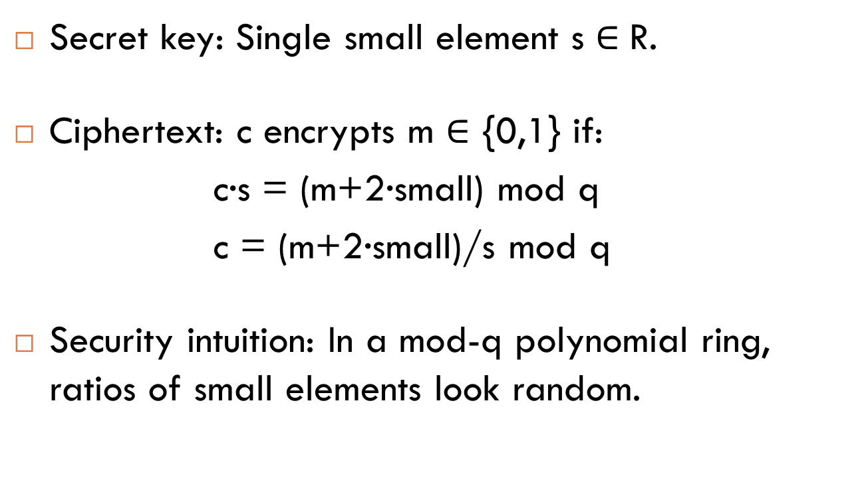
NTRU: Even Simpler Encryption Using Polynomial Rings
Secret key: Single small element s $∈$R.
Ciphertext: c encrypts m $∈$ {0,1} if:
c∙s = (m+2·small) mod q
c = (m+2·small)/s mod q
Security intuition: In a mod-q polynomial ring, ratios of small elements look random.

Slide 19
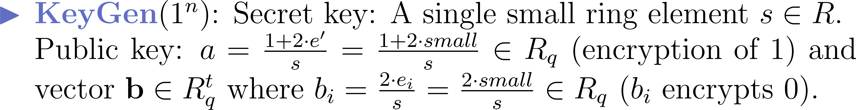
NTRU Details

Slide 20
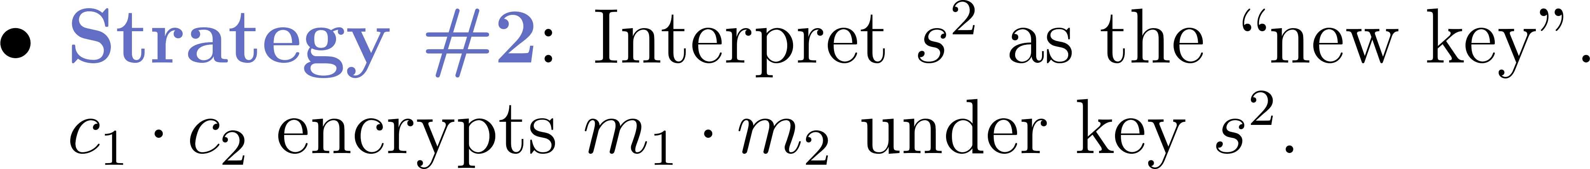
NTRU Homomorphic Operations

Slide 21
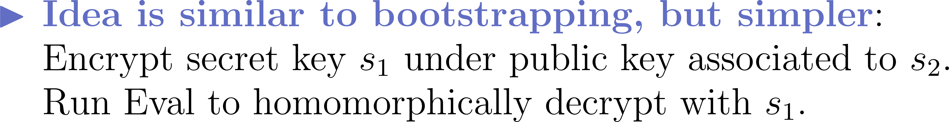
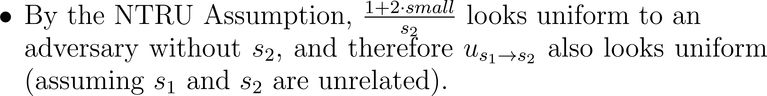
Key Switching from s₁ to s₂.

Slide 22
Managing Noise via Modulus Reduction
Suppose c encrypts m – that is, m = [[<c,s>]_{q}]₂.
Let’s pick p<q and set c* = (p/q)c, rounded.
Crazy idea: Maybe it is true that:
    c* encrypts m : m = [[<c*,s>]_{p}]₂ (new inner modulus).
Surprisingly, this basically works!
After modulus reduction (and dimension reduction), the size of the ciphertext is independent of the complexity of the function that was evaluated!

Slide 23
Modulus Reduction Magic Trick, Details
Scaling lemma: Let p<q be odd moduli. Suppose m = [[<c,s>]_{q}]₂ and |[<c,s>]_{q}| < q/2 - (q/p)·║s║₁. Set c’ = (p/q)c and set c” to be the integer vector closest to c’ such that c” = c mod 2. Then m = [[<c”,s>]_{p}]₂.
Annotated Proof:
1. For some k, [<c,s>]_{q} = <c,s> - kq.
2. (p/q)|[<c,s>]_{q}| = <c’,s> - kp.
3. |<c”-c’,s>| < ║s║₁.
4. Thus, |<c”,s>-kp|< (p/q) |[<c,s>]_{q}| + ║s║₁ < p/2.
5. So, [<c”,s>]_{p} = <c”,s> – kp.
6. Since c” = c mod 2 and p = q mod 2, we get [<c’’,s>]_{p}]₂ = [<c,s>]_{q}]₂.
1. Imagine <c,s> is close to kq.
2. Then <c’,s> is close to kp.
3. <c”,s> also close to kp if s small.

Slide 24
Homomorphic Computation on Encrypted Arrays (SIMD Operations)

Slide 25
Encrypted Arrays
Suppose we use a mod-15 plaintext space (not mod-2)
  Z₁₅ = Z₃ × Z₅. Chinese Remainder Theorem (CRT).
  From one “big” plaintext space we get 2 independent “small” plaintext spaces. We call them two “plaintext slots”.
Suppose two ciphertexts c and c’ have (r₃,r₅) and (r₃’,r₅’) in their respective mod-3 and mod-5 “plaintext slots”
  c_{ADD} = ADD(c,c’) has (r₃+r₃’, r₅+r₅’) in its slots.
  c_{MULT} = MULT(c,c’) has (r₃∙r₃’, r₅∙r₅’) in its slots.
  Homomorphic ops act component-wise, in parallel, on slots.

Slide 26
Our Weird Cyclotomic Plaintext Space
SWHE in Polynomial Rings
  Plaintext space is R₂ = Z₂[x]/Ф_{N}(x).
    The message m(x) is a polynomial in R₂.
    m has n bits, where n is the degree of Ф_{N}(x).
    NTRU example: m = [[c·s]_{q}]₂ over the ring R.
Can we get many “plaintext slots” out of R₂?
  Sure…

Slide 27
Our Weird Cyclotomic Plaintext Space
The plaintext space R₂ = Z₂[x]/Ф_{N}(x) has amazing properties! Much better than a mod-15 plaintext space!
Via CRT, R₂ decomposes into about N/log(N) plaintext slots of about log(N) bits apiece (for well-chosen N).
  ADD and MULT work in parallel across the slots.
Via ring automorphisms, encrypted data can be moved between slots.
  We have ADD, MULT, and PERMUTE.
Can evaluate boolean circuits with ciphertexts “packed”.
  Reduces overhead.

Slide 28
Chinese Remainder Theorem for Cyclotomic Rings
Choose N so that Ф_{N}(x) factors mod 2 into t factors.
  Ф_{N}(x) = ∏ f_{i}(x) mod 2. Degrees of f₁, …, f_{t} are d=φ(N)/t.
Chinese Remainder Theorem (CRT) – polynomial version
  Z₂[x]/Ф_{N}(x) = Z₂[x]/f₁(x) × … × Z₂[x]/f_{t}(x)
If ciphertexts c and c’ have (r₁(x),…,r_{t}(x)) and (r₁’(x),…,r_{t}’(x)) in their respective plaintext slots
  c_{ADD} = ADD(c,c’) has (r₁(x)+r₁’(x), …, r_{t}(x)+r_{t}’(x)).
  c_{MULT} = MULT(c,c’) has (r₁(x)∙r₁’(x) mod f₁(x), …, r_{t}(x)∙r_{t}’(x) mod f_{t}(x)).
  Homomorphic ops act component-wise, in parallel, on slots.

Slide 29
Permuting Encrypted Arrays and Ring Automorphisms

Slide 30
Beyond SIMD Computation
Goal: To reduce overhead for a single computation (rather than multiple computations in parallel):
  Pack all input bits in just a few ciphertexts
  Compute while keeping everything packed
How to do this?

Slide 31
Are ADD and MULT a Complete Set of Operations? Yes, for bits.
+
+
+
+
+
+
+
+
+
1
×
×
×
×
×
×
×
×
×
×
×
1
+
+
+
+
+
+
+
+
+
+
+
+
+
0
1
x₁
x₂
x₃
x₄
x₅
x₇
x₈
x₉
x₁₀
x₁₁
x₁₂
x₁₄
x₁₅
x₁₆
x₁₇
x₁₈
x₁₉
ADD and MULT are a complete set of operations.

Slide 32
Are ADD and MULT a Complete Set of Operations? No, for SIMD arrays.
+
+
+
+
+
+
+
+
+
1
×
×
×
×
×
×
×
×
×
×
×
1
+
+
+
+
+
+
+
+
+
+
+
+
+
0
1
x₁
x₂
x₃
x₄
x₅
x₇
x₈
x₉
x₁₀
x₁₁
x₁₂
x₁₄
x₁₅
x₁₆
x₁₇
x₁₈
x₁₉
x₁ | x₂ | x₃ | x₄ | x₅ |  | x₇
x₈ | x₉ | x₁₀ | x₁₁ | x₁₂ |  | x₁₄
n-ADD and n-MULT are NOT a complete set of operations.

Slide 33
n-ADD, n-MULT, n-PERMUTE: a complete set of SIMD ops on n-arrays
x₁ | x₂ | x₃ | x₄ | x₅ |  | x₇
x₁ | x₂ | x₃ | x₄ | x₅ |  | x₇
n-MULT
1 | 0 | 1 | 0 | 0 | 0 | 0
0 | 1 | 0 | 1 | 0 | 0 | 0
x₁ | 0 | x₃ | 0 | 0 | 0 | 0
0 | x₂ | 0 | x₄ | 0 | 0 | 0
n-PERMUTE(π)
x₁ | x₃ | 0 | 0 | 0 | 0 | 0
n-ADD
x₂ | x₄ | 0 | 0 | 0 | 0 | 0
+
+
x₁
x₂
x₃
x₄

Slide 34
Ring Automorphisms!
How do we Evaluate n-Permute(π) homomorphically, without “decompressing” the packed ciphertexts?

Slide 35
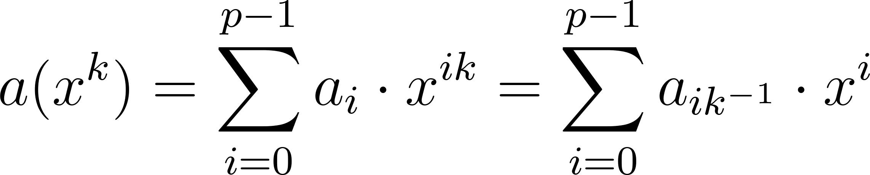
Ring Automorphisms
If a(x) is “small”, then φ_{k}(a(x)) is also “small”.
For simplicity, let R = Z[x]/(x^{n}-1), n prime
Consider the map φ_{k}: R → R given by:
φ_{k}(a(x)) = a(x^{k})
If gcd(k,p) = 1, φ_{k} permutes the coefficients of a(x):

Slide 36
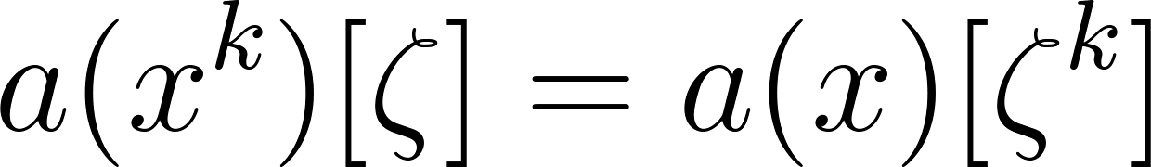
Ring Automorphisms
For simplicity, let R = Z[x]/(x^{p}-1), p prime
Consider the map φ_{k}: R → R given by:
φ_{k}(a(x)) = a(x^{k})
If gcd(k,p) = 1, φ_{k} permutes the coefficients of a(x):
φ_{k} permutes the evaluations of a(x) at roots of unity:
We can use φ_{k} to permute our plaintext slots.

Slide 37
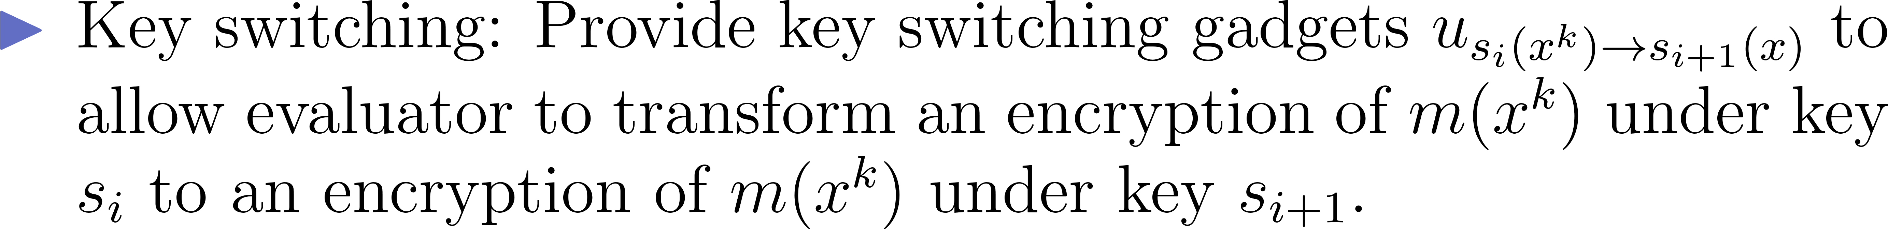
Homomorphic Automorphisms

Slide 38
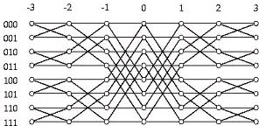
Which Permutations Do the Automorphisms Give Us?
The “Basic” Permutations (a(x) → a(x^{k})):
  Only n (out of n!) of the possible permutations.
  Think of the automorphisms as n-ROTATE(i), which rotates the n items i steps clockwise, like a dial.
Claim: For any permutation π, we can build n-PERMUTE(π) “efficiently” from n-ADD, n-MULT, and n-ROTATE(i).
Benes
permutation network

Slide 39
Asymptotic Efficiency Results
  Overhead of HE
  = (encrypted comp. time)/(unencrypted comp. time)
For RLWE-based or NTRU-based SWHE with ciphertext packing and security parameter k:
Overhead = poly(log q_{L}, log w) = poly(L, log k, log w),
where L and w are circuit depth and width.

Slide 40
Key Homomorphism and Multikey FHE
The Multikey FHE scheme of Lopez-Alt, Tromer, Vaikuntanathan

Slide 41



Key Homomorphism in NTRU

Slide 42
LATV Multikey FHE Scheme
[LATV12]: Cloud can (noninteractively) combine data encrypted under different keys.
  Individual secret keys are s₁, …, s_{n}.
  Combined secret key is s₁···s_{n}.
To decrypt, all users whose data was used must cooperate.
Getting FHE:
  I showed how to combine keys to get multikey SWHE.
  LATV show how to get multikey FHE.

Slide 43
Part IV: FHE from Non-Abelian Groups?
A somewhat promising framework for FHE inspired by Barrington’s Theorem

Slide 44
Goal: Totally Different Approach to FHE
FHE without noise?
  Might also make (expensive) bootstrapping unnecessary
How about FHE based on non-abelian groups?
  Might avoid linear algebra attacks for ring-based schemes
  Another chance to apply Barrington. ☺
  Framework investigated by Nuida
    ePrint 2014/07: “A Simple Framework for Noise-Free Construction of Fully Homomorphic Encryption from a Special Class of Non-commutative Groups”

Slide 45
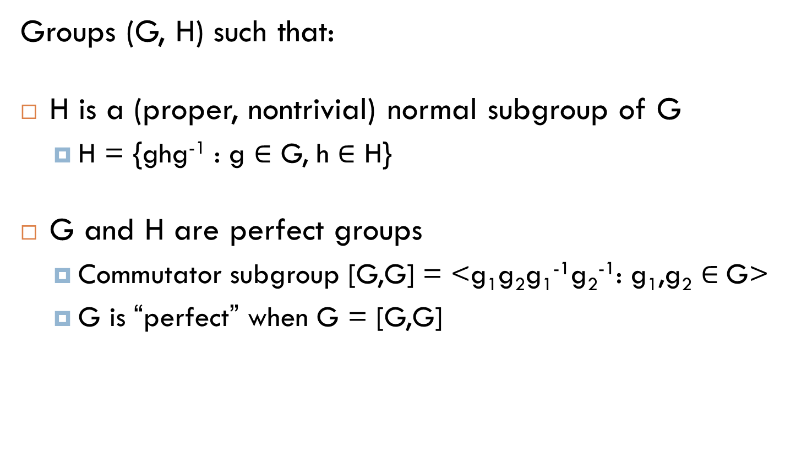
Perfect Group Pairs
Groups (G, H) such that:
H is a (proper, nontrivial) normal subgroup of G
  H = {ghg⁻¹ : g $∈$ G, h $∈$ H}
G and H are perfect groups
  Commutator subgroup [G,G] = <g₁g₂g₁⁻¹g₂⁻¹: g₁,g₂ $∈$G>
  G is “perfect” when G = [G,G]

Slide 46
Efficient Group Operations
Randomization: Given a group (say, G) represented by some generators, output ≤n “random” G-elements that generate the group.

Slide 47
Hardness Assumption
Subgroup Decision Assumption (for perfect group pairs): Given ≤n elements that generate either G or H, hard to distinguish which.

Slide 48
FHE Construction
Public key:
  An encryption of 0: n elements that generate G
  An encryption of 1: n elements that generate H
Secret key: Trapdoor to distinguish G from H (represented by generators).
Encryption: Randomize the encryption of 0 or 1.
AND gate: Given generators of groups K1, K2, output generators of the union of K1,K2. (Use union of generators.)
OR gate: Given generators of groups K1,K2, output generators of intersection of K1,K2. (Use commutator.)
  G = [G,G], H = [H,H], H = [G,H].

Slide 49
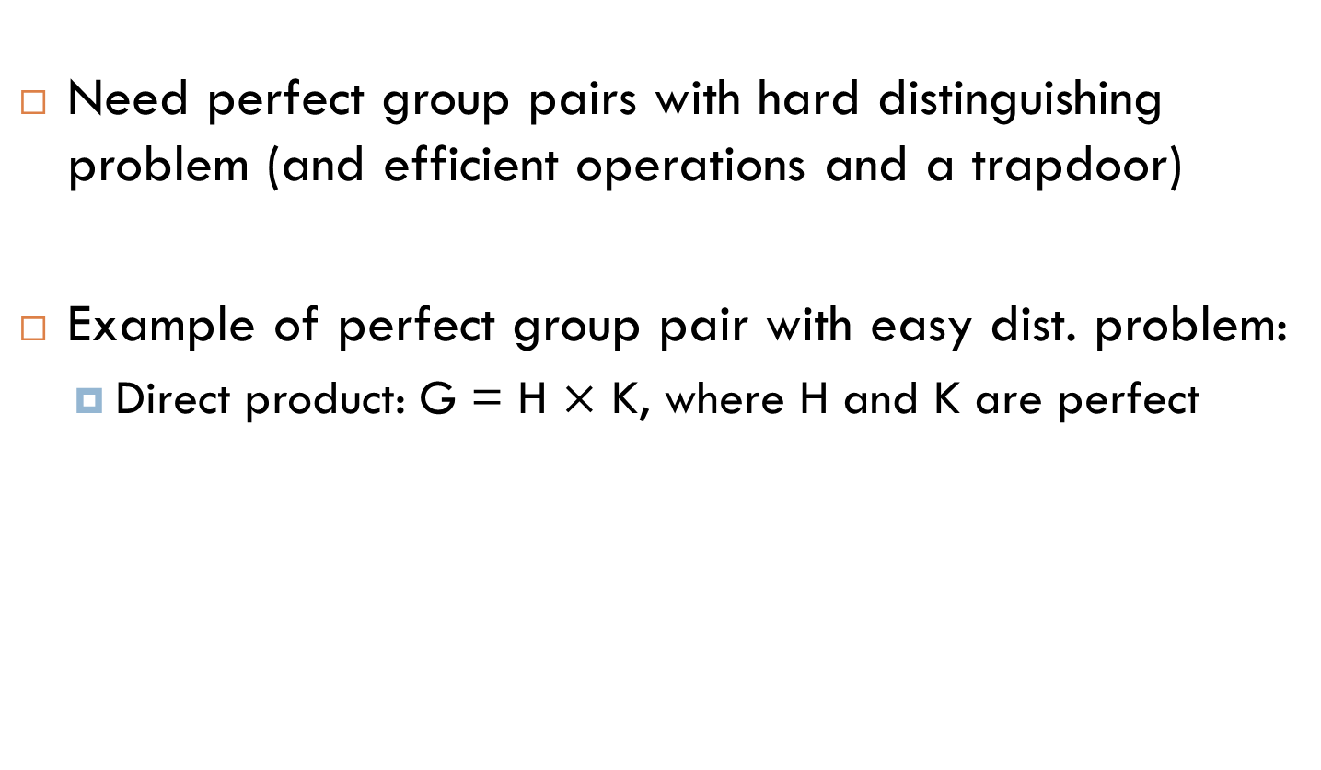
Existence?
Need perfect group pairs with hard distinguishing problem (and efficient operations and a trapdoor)
Example of perfect group pair with easy dist. problem:
  Direct product: G = H $×$ K, where H and K are perfect

Slide 50
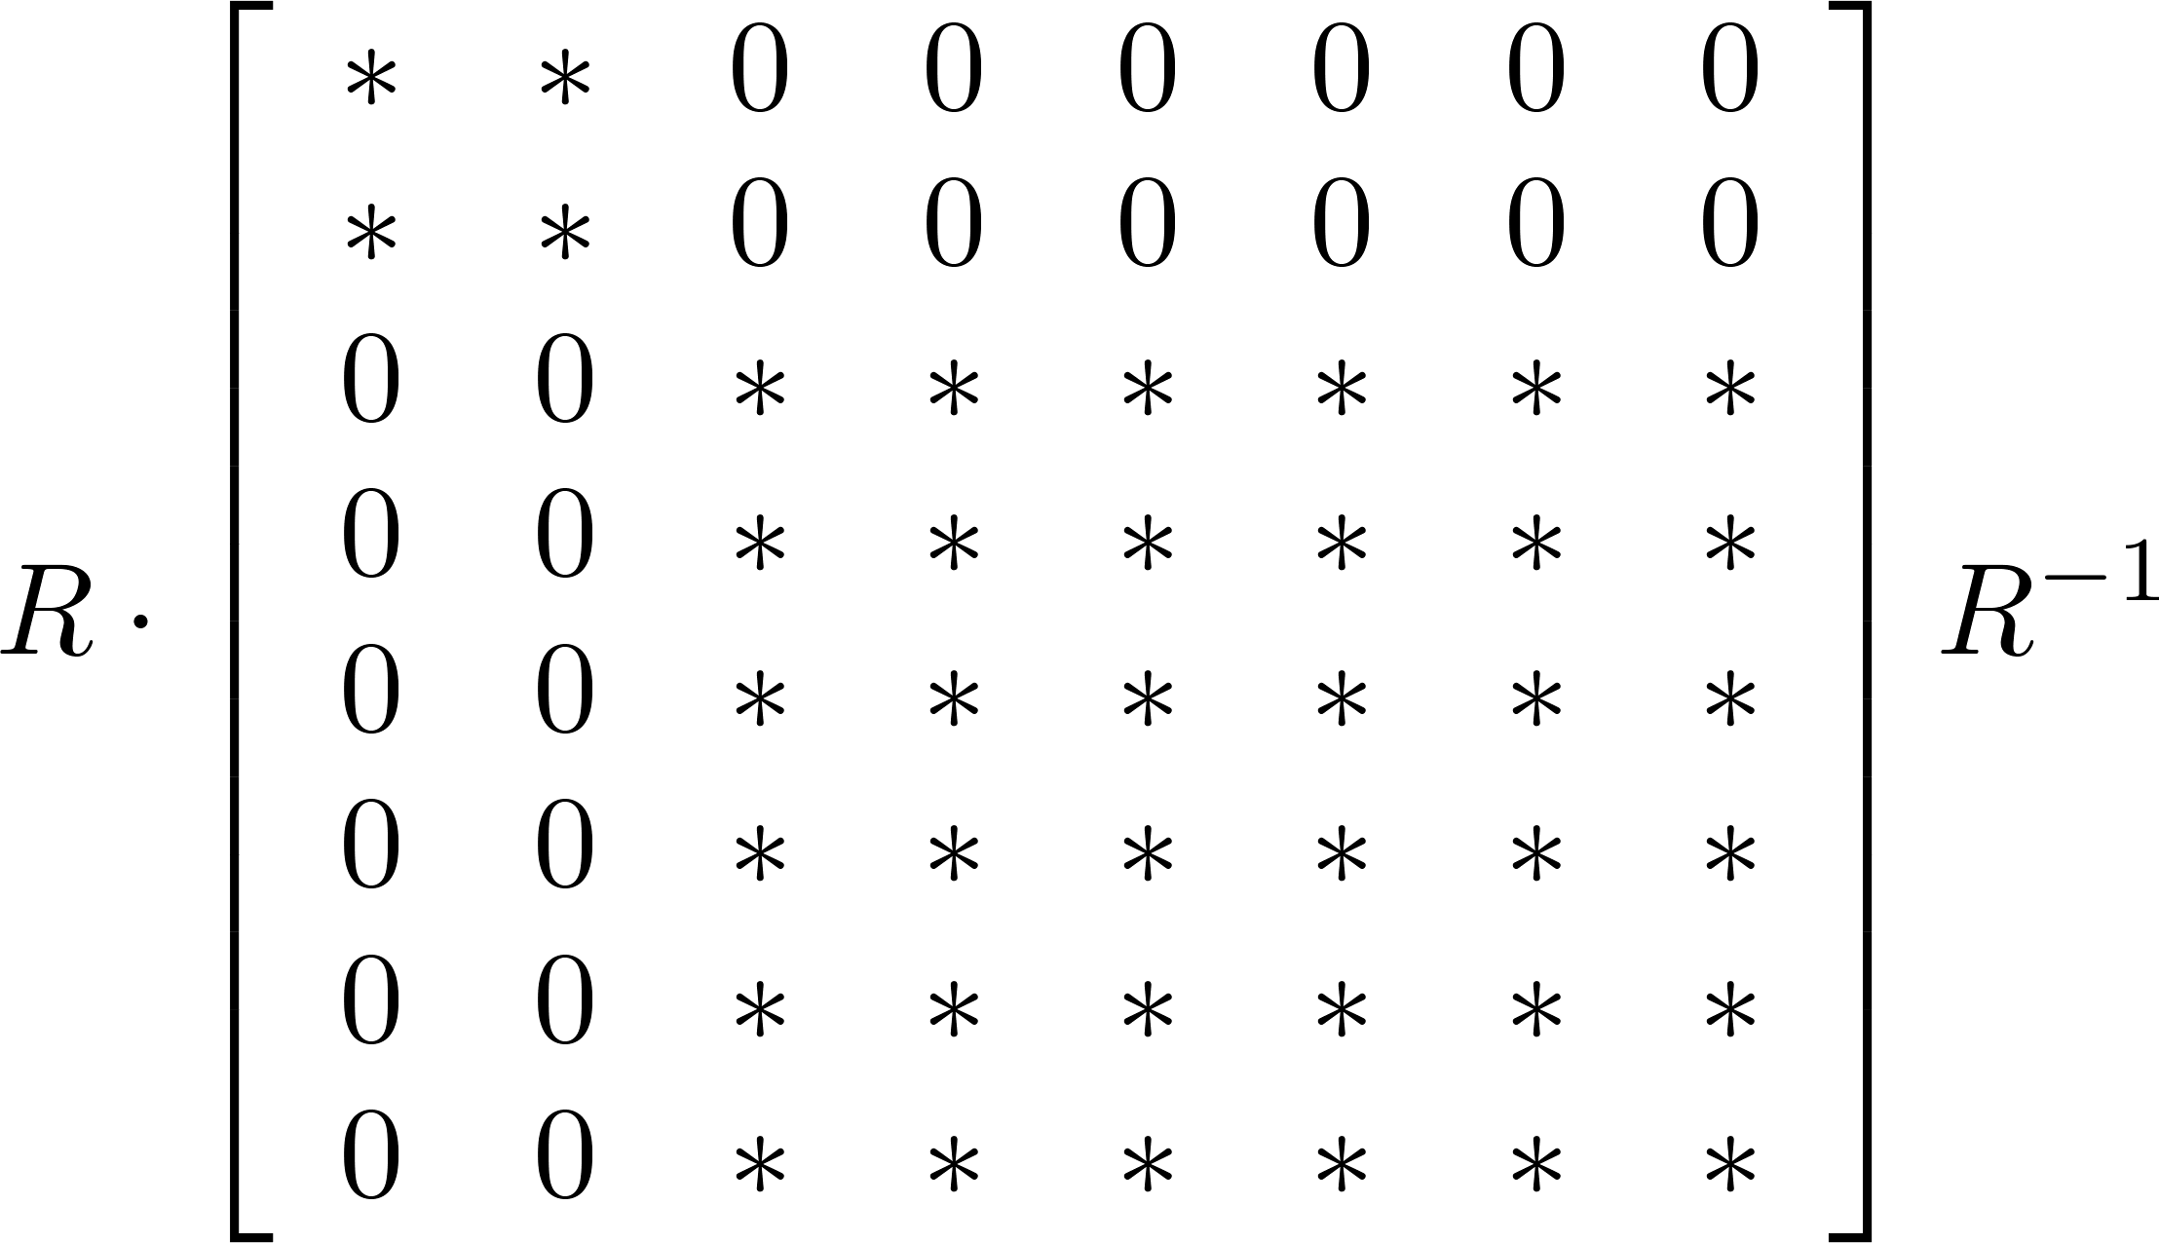
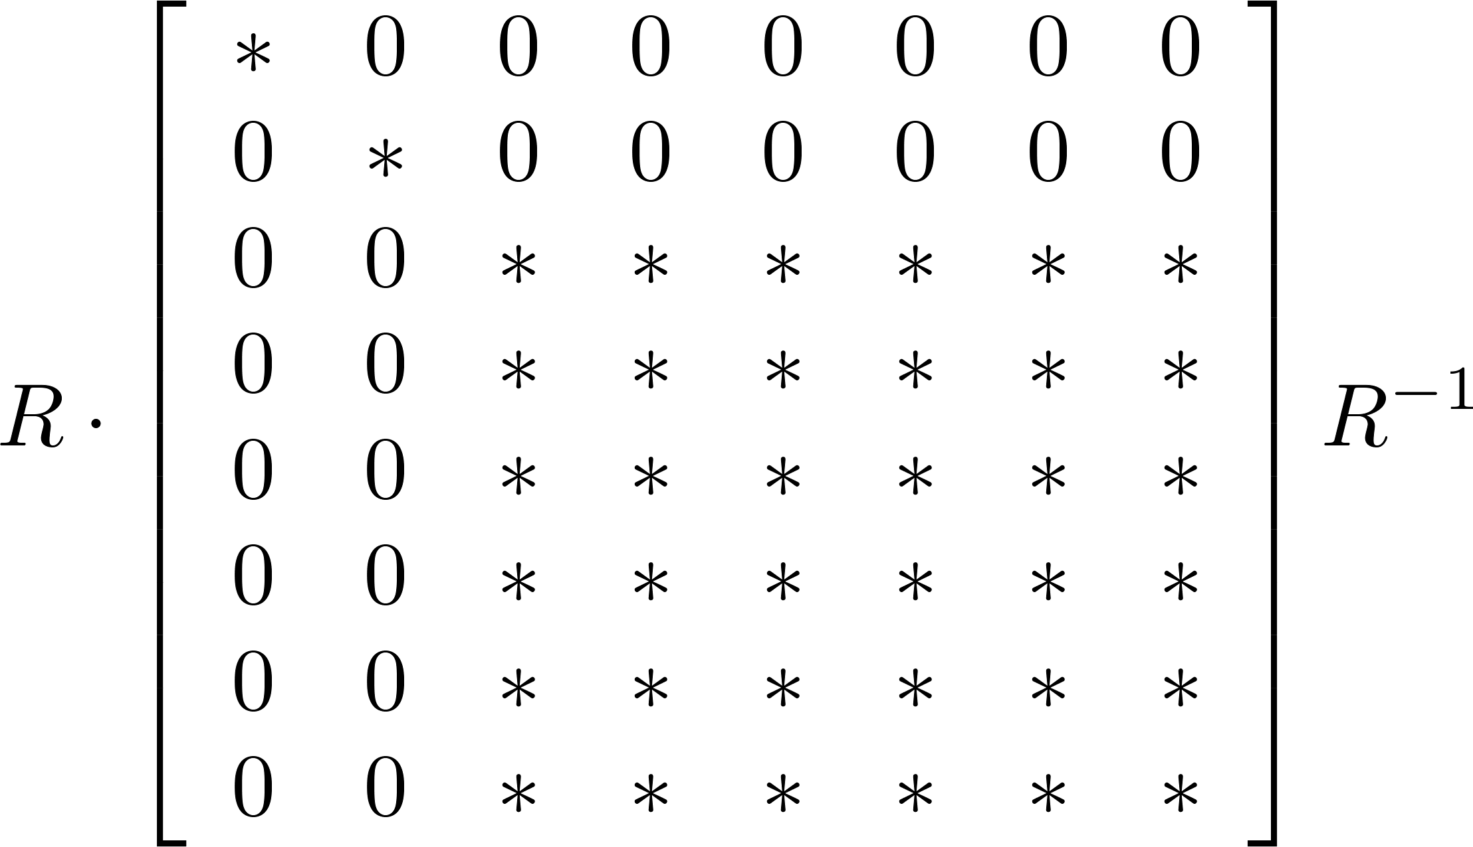
Failed Attempt
Form of G elements
Form of H elements
Linear algebra attack: Encryptions of 0 in proper subspace
Is there a patch? Can we use non-abelian groups without fatally embedding them in a ring? (representation theory)

Slide 51
Thank You! Questions?
TIME
EXPIRED
?
?

