Slide 1







FAEST
Emmanuela Orsini
Carsten Baum
Christian Majenz
Lennart Braun
Lawrence Roy (Lance)
Peter Scholl
Sebastian Ramacher
Cyprien Delpech de Saint Guilhem
Shibam Mukherjee
Christian Rechberger
Michael Klooß

Slide 2
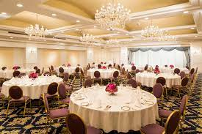

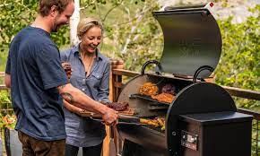
(post-quantum) Signature dishes
Banquet
Picnic
BBQ

Slide 3

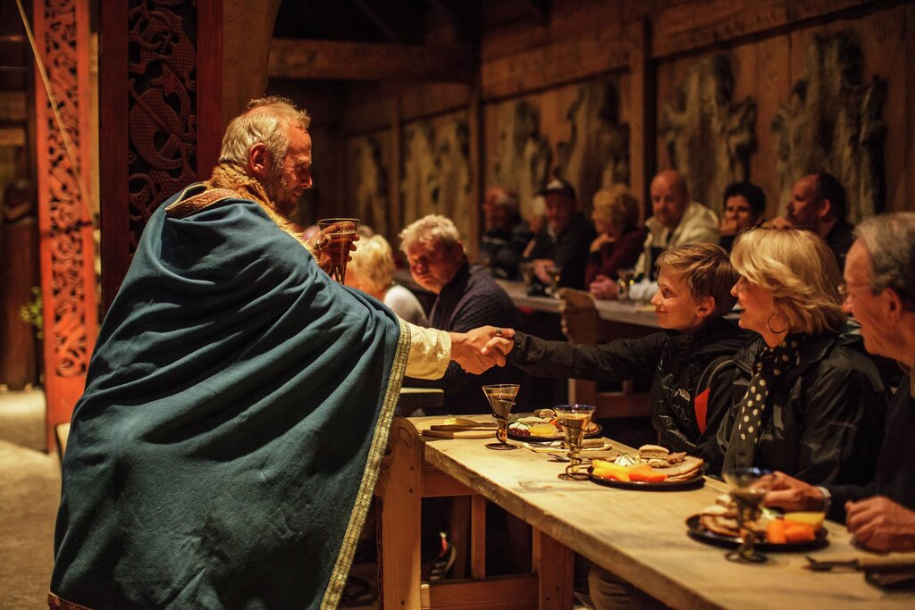
Bringing to you: The FAEST

Slide 4
Based on
Publicly Verifiable Zero-Knowledge and Post-Quantum Signatures From VOLE-in-the-Head
Carsten Baum, Lennart Braun, Cyprien Delpech de Saint Guilhem, Michael Klooß,
Emmanuela Orsini, Lawrence Roy, Peter Scholl
CRYPTO 2023
No VOLEs were harmed while making this presentation

Slide 5
Families of ZK Proofs
Linear
MPC-in-the-head
Proof size
VOLE-ZK
Ligero
Succinct
Size: $$≈1×$$ bit per AND gate
designated verifier
STARKs
...
Prover runtime
Notes:
Succinct proofs tend to have higher fixed costs, so their advantage relative to linear proofs only becomes significant for larger proof sizes.
On the other end of the tradeoff, there is MPC in the head. I’d like to thank yesterday’s presenters for covering this topic thoroughly.

Slide 6

VOLE-in-the-Head: a general tool for making VOLE-ZK proofs publicly verifiable
Speed
Linear size
Security
AES/SHA
11-16x witness
Application: FAEST post-quantum
signature scheme

Slide 7
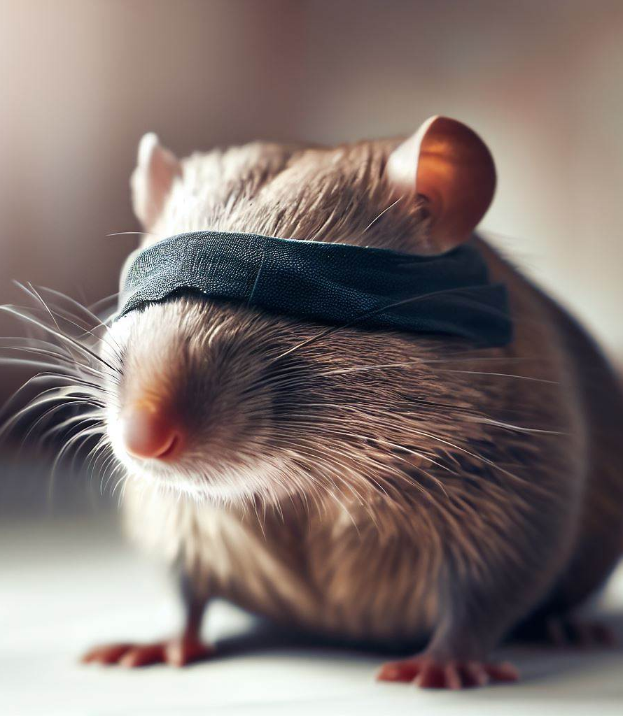
VOLE-ZK
in the designated verifier setting

Slide 8


Background: VOLE
(vector oblivious linear evaluation)
Prover
Verifier
$$p(x)=ux+v$$
$$Δ←𝔽$$
$$q$$
$$\vec{u} ∈ 𝔽^{n}$$
VOLE
$$\vec{v}←𝔽^{n}$$
$$\vec{q}=\vec{u}Δ+\vec{v}$$
Can be instantiated with OT, HE, LPN…
$$Δ$$

Slide 9
ZK from VOLE (designated verifier)
[BMRS 21, WYKW 21]
Use VOLE as a linear commitment to $$\vec{u}$$
To open
Prover sends $$(u,v)$$, Verifier checks if $$q=uΔ+v$$
Hiding: since $$v$$ is random
Binding: opening to $$u^{′}≠u$$ requires guessing $$Δ$$ — prob. $$1/|𝔽|$$
(as long as $$Δ$$ is kept secret from Prover ⟶ D.V.)
Commitments are linearly homomorphic
$$p(x)=ux+v$$
$$q$$
$$p′(x)$$
$$Δ$$

Slide 10
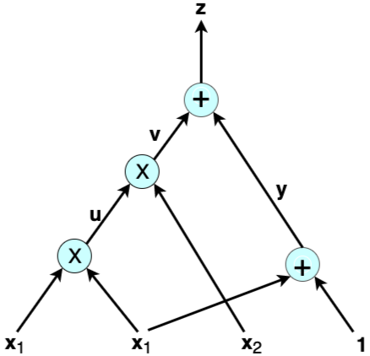
ZK from VOLE via Commit-and-Prove
[BMRS 21, WYKW 21]
Commit to witness $$\vec{u}$$
Evaluate $$C$$ gate-by-gate:
  Linear gates: easy
  Multiplication: ???

Slide 11
Multiplication check (QuickSilver)
[DIO 21, YSWW 21]
$$a$$
$$c$$
$$×$$
$$b$$
Multiply two lines $$⇒$$ quadratic polynomial
  $$p_{ab}\left(x\right)=d_{0}+d_{1}x+abx^{2}$$
Commit to output $$c$$ $$⇒$$ $$p_{c}\left(x\right)=v+cx$$
$$p_{ab}\left(x\right)−xp_{c}(x)$$ should be degree-1
  Open and check
  First, mask with random deg-1 commitment
$$p_{a}(x)$$
$$q_{1}$$
$$q_{3}=p_{ab}(Δ)$$
$$p_{ab}(x)$$
$$q_{2}$$
$$p_{b}(x)$$
$$Δ$$

Slide 12
Cost analysis for VOLE-ZK
Per multiplication gate:
  Commit to $$c$$
    $$1×$$ VOLE element
  Open masked commitment
    Can be amortized to constant size (check random combination of polynomials)
For circuit:
  $$m+n$$ field elements for $$m$$ inputs and $$n$$ mult. gates (assuming LPN-based VOLE)
  Improvements:
    General deg-2 and higher degree gates; branching; field switching…

Slide 13

VOLE-in-the-Head
Adding public verifiability

Slide 14

MPC-in-the-Head vs VOLE-in-the-head: high-level differences
$$u_{1}$$
challenge
MPC protocol $$Π$$ for
$$C(u_{1}+⋯+u_{n})$$
$$u$$
$$⋮$$
$$n−1$$ views from $$Π$$
$$u_{n}$$
$$u=u_{1}+⋯+u_{n}$$

Slide 15
How to do VOLE? Warm-up: using OT
Key observation: $$n$$-out-of-$$n$$ secret sharing + OT $$⇒$$ VOLE in $$𝔽_{n}$$
(from SoftSpokenOT [Roy 22])
$$u_{1}$$
$$(n−1)$$-out-
of-$$n$$ OT
Pick $$Δ←𝔽_{n}$$
$$u$$
$$⋮$$
$$⋮$$
$$u_{i}$$
for $$i≠Δ$$
$$u_{n}$$
$$q=\sum_{i}{u_{i}⋅(Δ−i)}$$
$$=uΔ+v$$
$$u=u_{1}+⋯+u_{n}$$
$$v=−1⋅u_{1}−⋯−n⋅u_{n}$$ (in $$𝔽_{n}$$)
0 when $$i=Δ$$

Slide 16

How to do VOLE-in-the-head?
All-but-one
vector commitment
Commit to $$n$$ random strings
$$⋮$$
Run VOLE-ZK proof
Challenge $$Δ$$
Open $$n−1$$
GGM tree (similarly to hypercube)
Convert to VOLE
$$\vec{u}, \vec{v}$$
$$\vec{q}=\vec{u}Δ+\vec{v}$$

Slide 17
VOLE-in-the-head: some details
$$(n−1)$$-out-of-$$n$$ vector commit $$⇒$$ VOLE in $$𝔽_{n}$$
  Commitments have soundness error $$\frac{1}{n}$$ ☹
  What about $$𝔽_{m}$$ for large $$m$$?
For extension fields, $$m=n^{τ}$$:
  Repeat $$τ$$ times, with same $$u ∈ 𝔽_{n}$$
  Cost over $$𝔽_{2}$$, 11-16 bits per AND (for 128-bit security)
Needs consistency check

Slide 18
More details: consistency checking
When repeating $$τ$$ times:
  Need to ensure prover uses consistent $$u$$
Consistency check from [Roy 22]:
Security:
  Needs new analysis for round-by-round soundness with Fiat-Shamir
Universal hash function $$R$$
$$\tilde{u}=R\vec{u}$$, $$\tilde{v}=R\vec{v}$$
Check $$R\vec{q}=\tilde{u}Δ+\tilde{v}$$

Slide 19
FAEST
Post-quantum signature

Slide 20
Paradigm for ZK-based signatures
Signature:
  NIZK proof of knowledge of $$sk$$, such that $$pk={Enc}_{sk}\left(x\right)$$
Challenge: finding a ZK-friendly $$Enc$$
  Custom ciphers: e.g. LowMC, MiMC
  Other assumptions: code-based, multivariate…

Slide 21
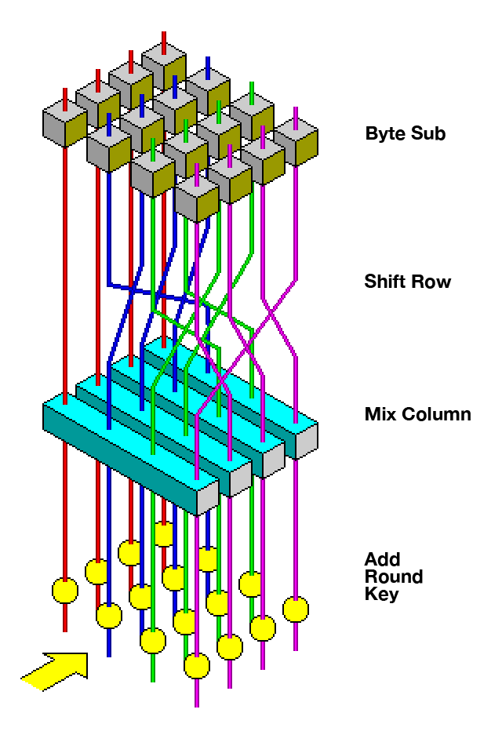
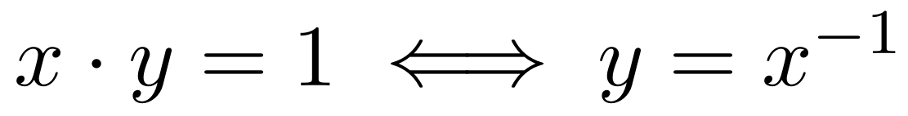
AES: a ZK-friendly OWF?
ShiftRows, MixColumns, AddRoundKey:
  All linear over $$𝔽_{2}$$
S-Box:
  Inversion in $$𝔽_{2^{8}}$$
  Prove in ZK as 1 multiplication constraint

Slide 22
Proving AES-128 in FAEST
Witness: key + internal state of each round (+ key schedule)
1600 bits (in $$𝔽_{2}$$)
200 constraints over $$𝔽_{2^{8}}$$:
1 per S-box:
  degree-2 polynomial: $$xy=1$$
What if $$x=0$$?
  Sample $$k$$ such that this never happens
  1-2 bits less security (for AES-128)
$$0$$ if $$x=0$$
$$x^{−1}$$ o.w.
(in $$𝔽_{2^{8}}$$)
$$x$$
$$y=$$
S-Box

Slide 23
FAEST summary: proving $$pk=AES_{sk}(x)$$
$$chall_{1}$$
$$\vec{q}=\vec{u}Δ+\vec{v}$$
$$chall_{2}$$
Commit to $$sk$$ and $$state$$
after each round
VOLE consistency check
$$chall_{3}$$
S-Box
Mult. check
Open VOLE outputs

Slide 24
FAEST performance (AVX2 + AES-NI)
 | Sign/Verify | Size
FAEST-128s | $$≈$$ 8ms | 5 006 B
FAEST-128f | $$≈$$1ms | 6 336 B
FAEST-256s | $$≈27$$ms | 22 100 B
FAEST-256f | $$≈3$$ms | 28 400 B
Timings are from my laptop: AMD Ryzen 7 5800H, 3.2–4.4 GHz
Signature sizes:
  Smaller than SPHINCS+ and most code-based candidates
  Faster signing, slower verification
Even-Mansour variant: $$Enc_{k}\left(x\right)=AES_{x}\left(k\right)⊕k$$
  10-15% smaller because of fixed key schedule

Slide 25
Work in progress
Better domain separation
Tighter proofs
Parameter tweaking:
  Smaller signatures
  Faster verification
Other OWFs:
  Pure MQ: size $$≈3$$ kB
  Rain cipher

Slide 26
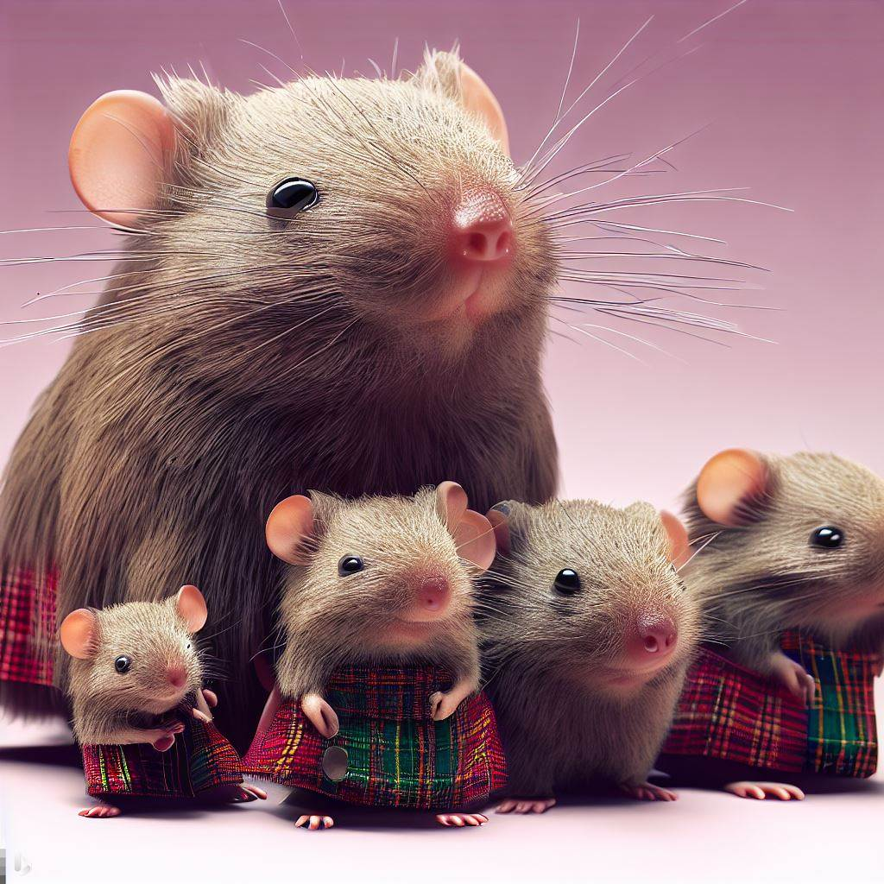
Conclusion
Thank you!
VOLE-ZK proofs:
Lightweight and fast with linear size
VOLE-in-the-head: publicly verifiable
FAEST signature:
Conservative security
Reasonable performance

